Slide 1
Program Analysis
Nelson
16/01

Slide 2
Agenda
Program structure analysis
Modifications
Demo

Slide 3
Program Structure Analysis
Frontend
Avatar model from ReadyPlayerMe
Packed into a reactjs application
Backend
ExpressJS as backend
POST request (/chat) as the main endpoint to process message sent from frontend

Slide 4
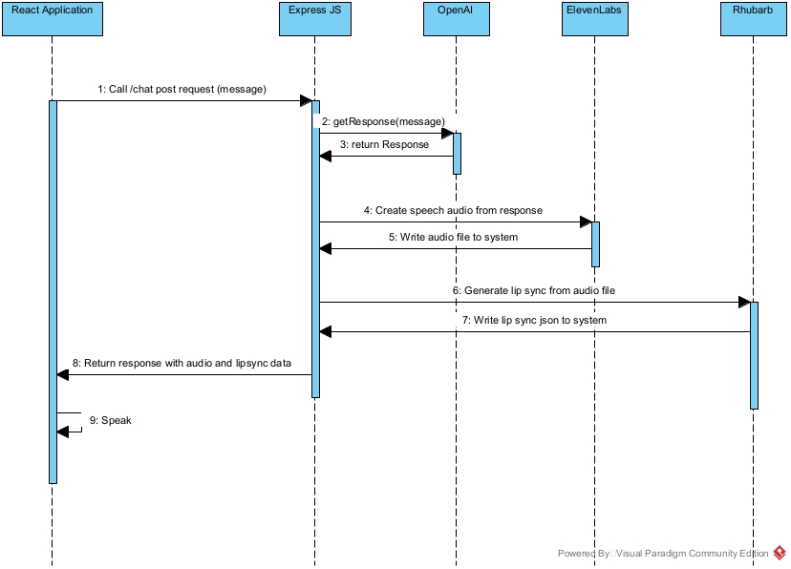
Program Structure Analysis

Slide 5
Modification
Some attempts made to directly call the /chat endpoint from Python
Resolved some issues with the API calls to external libraries (Wrong voiceid etc.)
Able to generate audio and lip sync data
Failed as it does not respond to the react application itself

Slide 6
Modification
Solution (Hijack the /chat endpoint)
Create endpoint in express js to store a temporary message
Create a loop from react to keep calling the chat endpoint
Chat endpoint only processes the message if a temporary message is present

Slide 7
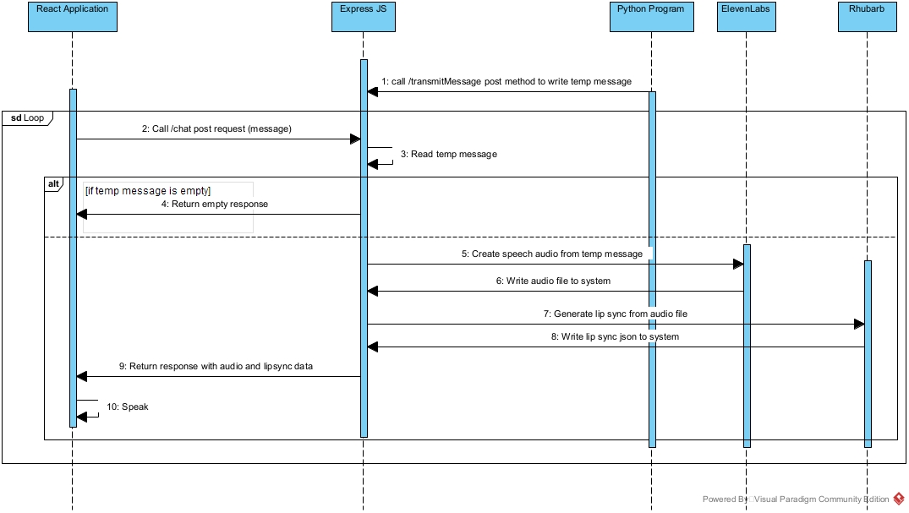
Modified structure

Slide 8
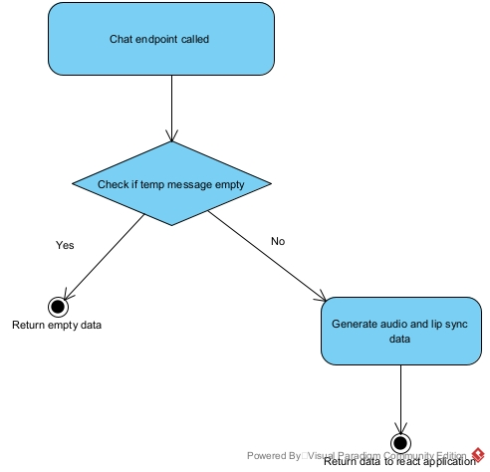
Modified logic flow

Slide 9
Demo time
Any Questions?

